Slide 1

Sprocket Central Pty Ltd
Data analytics approach
Tanveer Aalam – Data Analyst

Slide 2
Agenda
Introduction
Data Exploration
Model Development
Interpretation

Slide 3
There are quite a few metrics from the dataset that will help marketing team boost their business by targeting the new customers:
Age group
Job industry
Tenure period
State of customer
Discount rate over period
Month of purchases
Brand of product

Slide 4
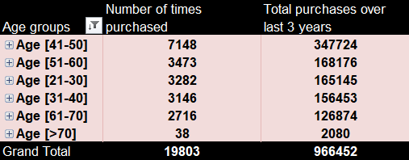
Age groups VS products purchased
The customers from age-group 41-60 can be targeted for better sales
Customers from age-group 41-60 accumulate around 50% of the purchases done while people of age >60 has least contribution with respect to purchases.
According the table, it is better to target customers from 21-60 age group people.

Slide 5
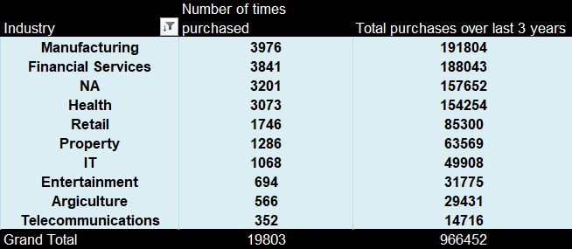
Industry VS products purchased
Customers from manufacturing, finance, health industry contribute a lot with respect to purchases
People from manufacturing, financial services, health are aggressive buyers, while customers from retail, property, IT are moderate buyers and people from entertainment, agriculture and telecommunications are least buyers from the table beside.

Slide 6
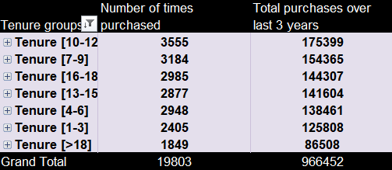
Years of tenure VS product purchases
Customers with experience level from 7-12 should be targeted for better sales pattern
People with tenure level 7 to 12 has highest percentage of purchases with around 35% contribution coming from them itself while those with over 18 years are least buyers

Slide 7
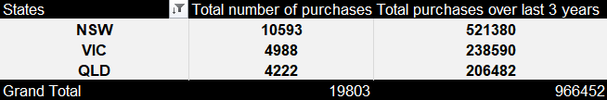
States VS products purchased
Customers from New South Wales purchase heavy amount of products and are better customers than the other 2 states
People from NSW could be a better target since the purchases from NSW customers contribute a whooping 55% alone while the other two states – Victoria and Queensland also perform better in terms of sales

Slide 8
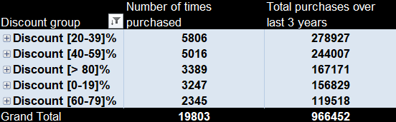
Discount effects on purchases
Customers tend to purchase at larger rate when there is a discount offer from 20-60% on the products
The organization must often target customers by releasing discount offers, especially around 20-60% range. Surprisingly the customers doesn’t seem to be attracted to products when they are available in 60-80% discount range

Slide 9
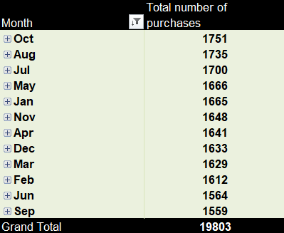
Month VS products purchased
Production should be increased by a bit during the months of Jul, August, October
Even though the purchase rate seems to be almost equal over the period of months, there is a better performance during months of July, August, October.
Surprisingly, September seems to be weakest month which falls between August and October, which needs to be looked at.

Slide 10
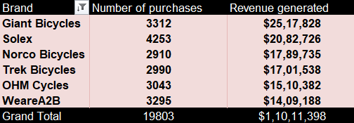
Brand VS products purchased
Customers tend to like Solex brand products but revenue is generated better by Giant Bicycles brand
People should be targeted with brands like Solex, Giant Bicycles as they seem to be the better performers among the lot.
Narco Bicycles and Trek Bicycles seems to be purchased fewer times when compared to the others but have been a good revenue generator than OHM and WeareA2B brands.

